Slide 1
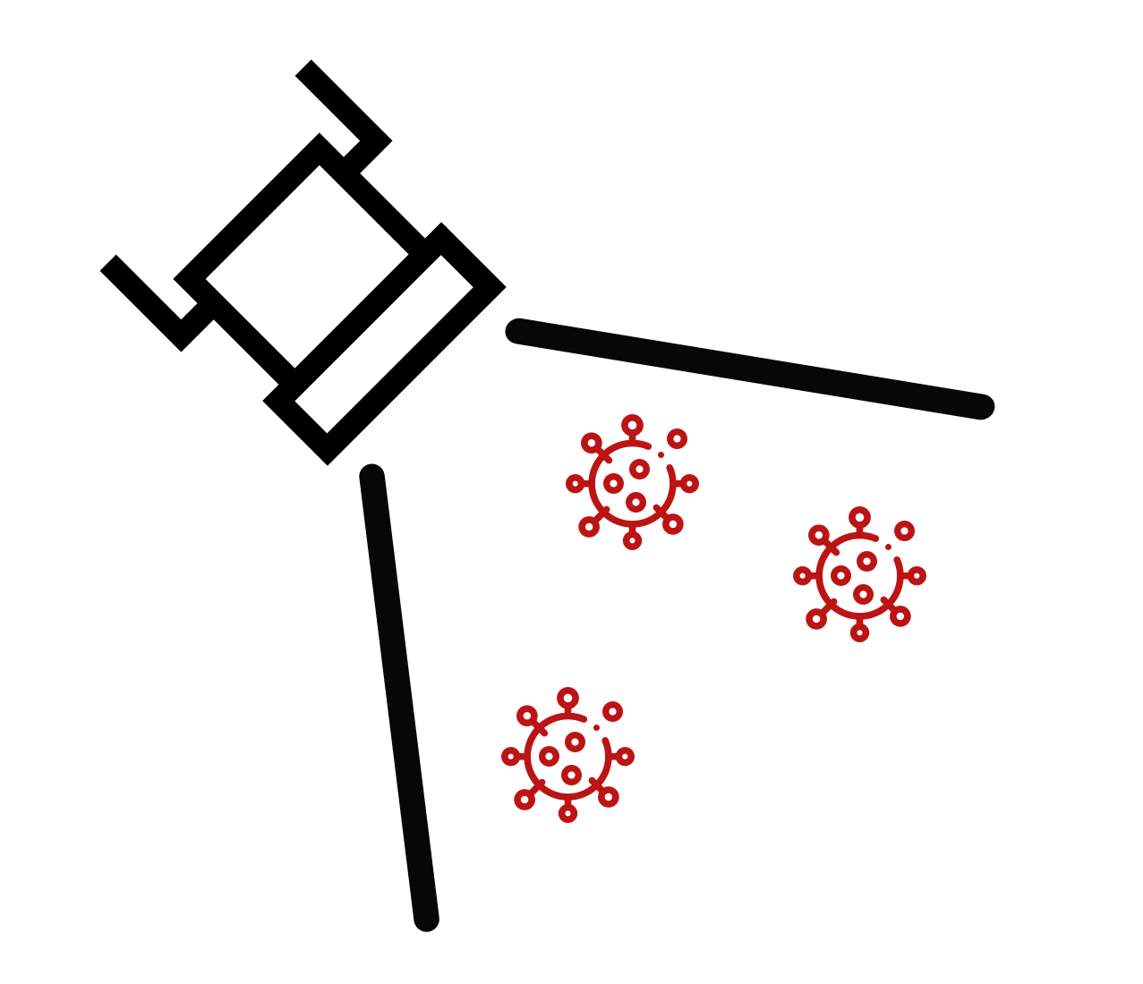
FloodLAMP
Biotechnologies, PBC
Decentralized, Rapid Molecular
Disease Screening for $1
Randy True, Founder and CEO | randy@floodlamp.bio

Slide 2
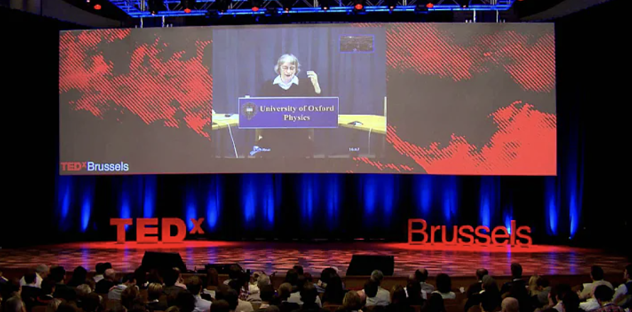

The Unknowable and How to Prepare for it
David Deutsch, “The Unknowable & how to prepare for it” at TEDxBrussels – (YouTube)

Slide 3
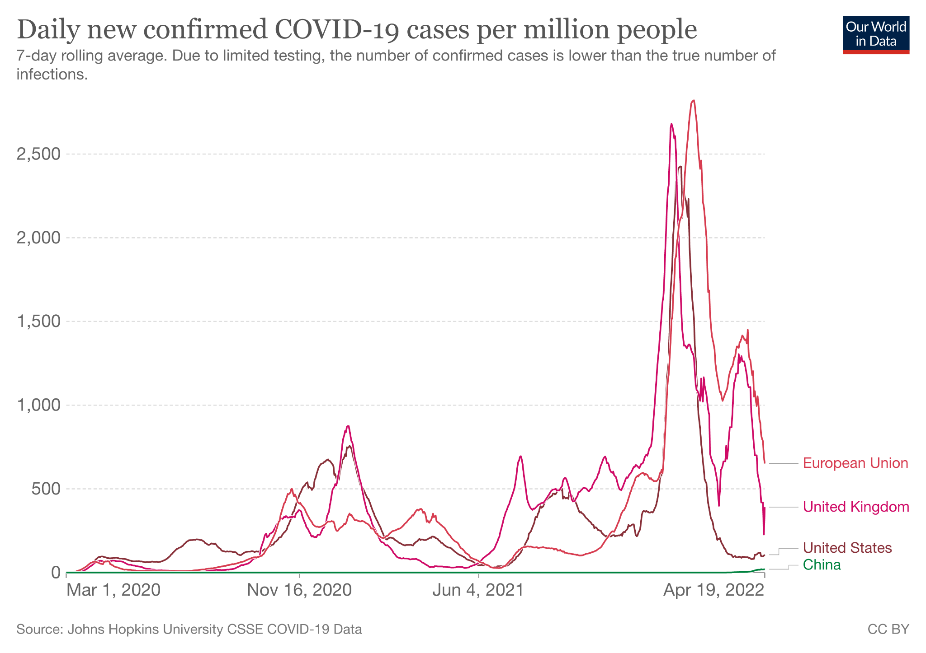
We still don’t know how to prepare for another variant OR the next pandemic
‹#›

Slide 4
Ideal Profile of Screening Tests
1
Decentralized
Local control, scalable during surge
2
Rapid
<1hr turn around time
3
Molecular
Greater accuracy compared to antigen tests
More quickly adaptable to new targets
Vestibulum congue tempus
4
$1
Low cost is critical for accessibility and wide distribution
¹ Antigen tests catch only 23% of new asymptomatic infections same day as PCR ; 47% within 48 hrs Comparison of Rapid Antigen Tests’ Performance between Delta (B.1.61.7; AY.X) and Omicron (B.1.1.529; BA1) Variants of SARS-CoV-2: Secondary Analysis from a Serial Home Self-Testing Study

Slide 5
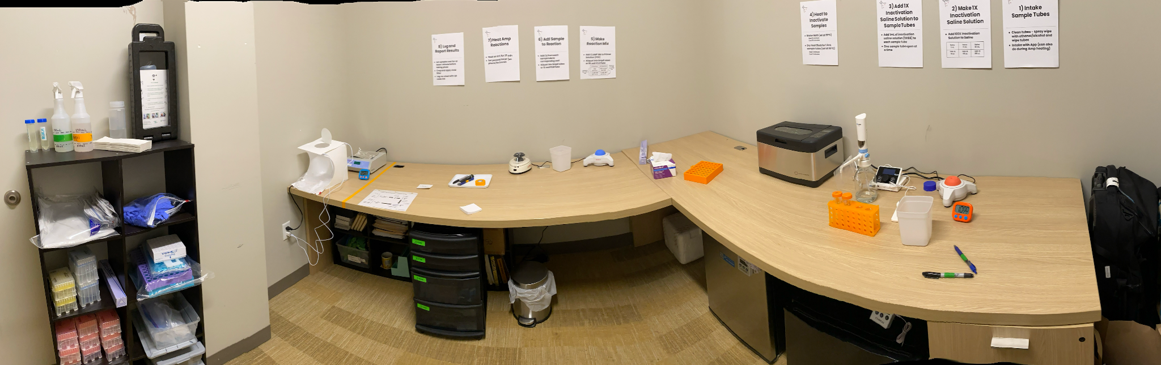
What This Looks Like
Programs operating in the real world, at the price of $1.25 per person
‹#›

Slide 6
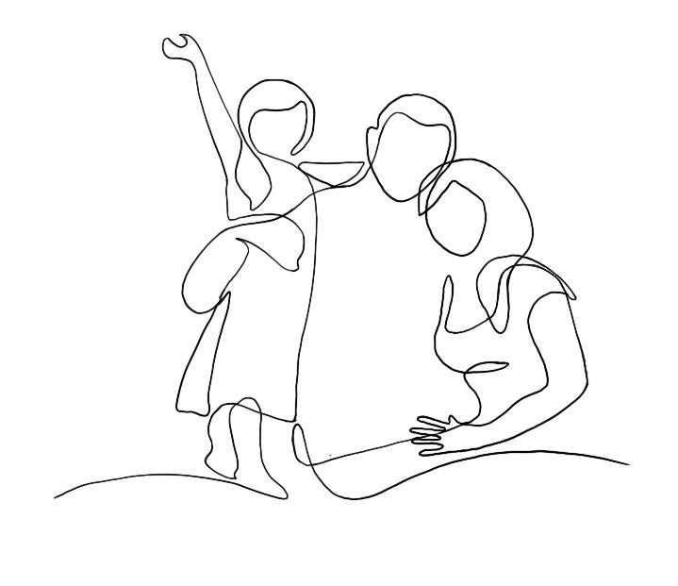
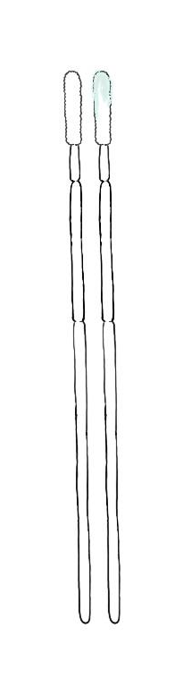

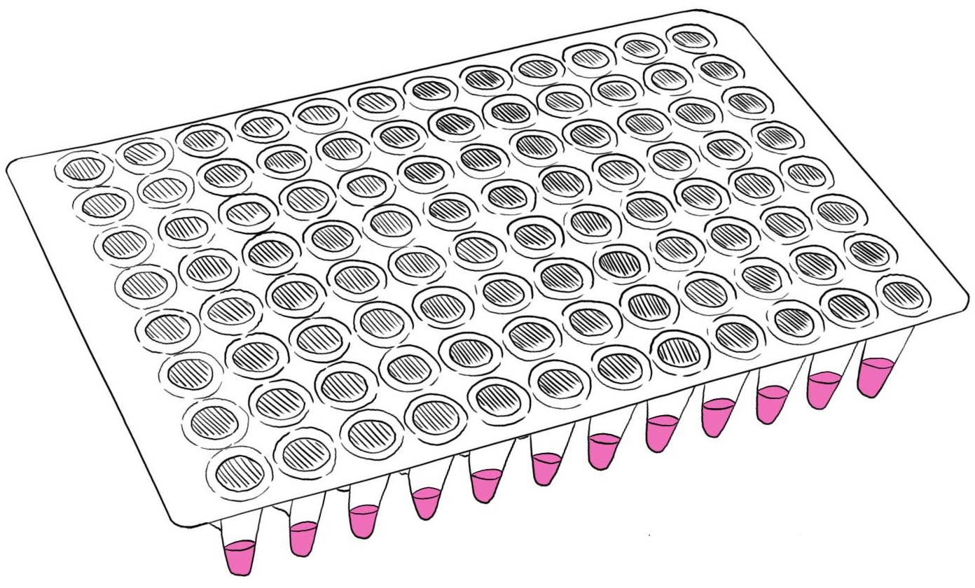
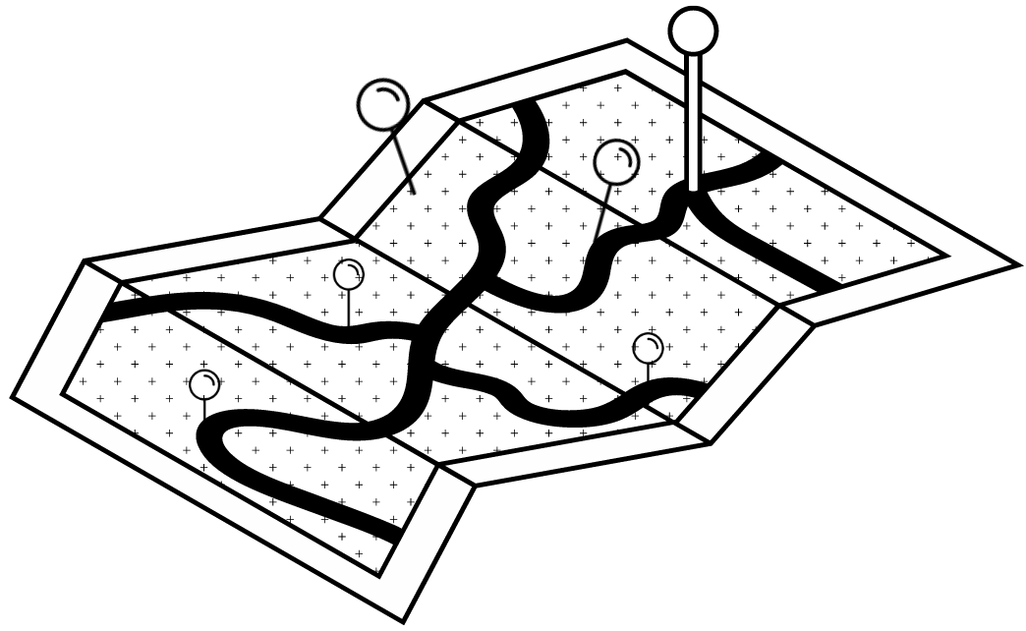
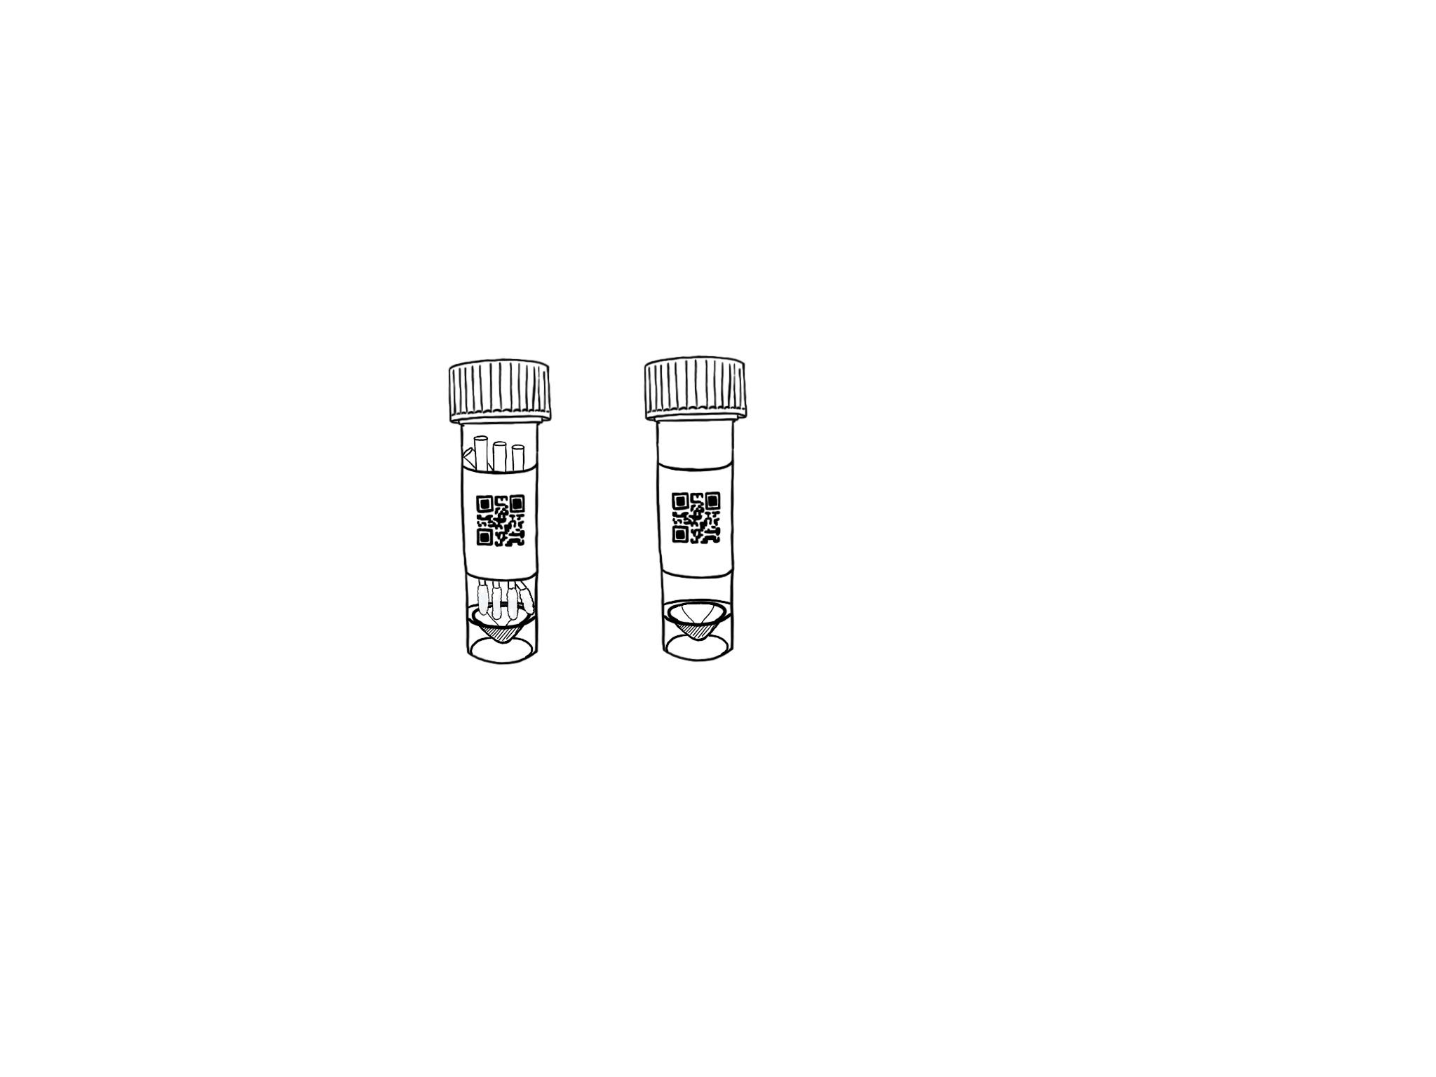
A Disease Screening Program for Resiliency
1
2
3
At-home Accessioned Collection with Mobile App
Family/ Household Pooling
Rapid Molecular LAMP Test
<1hr True TAT
Run On or Near Site
Streamlines test processing
Extends protection

Slide 7
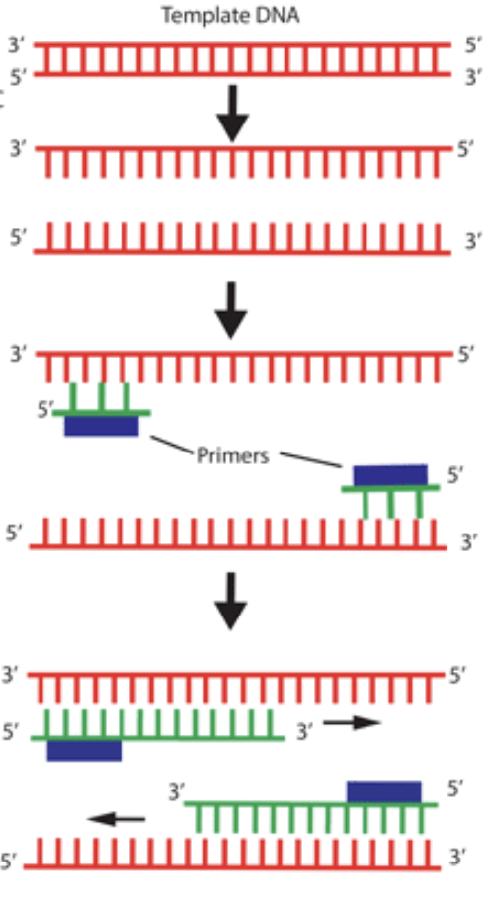
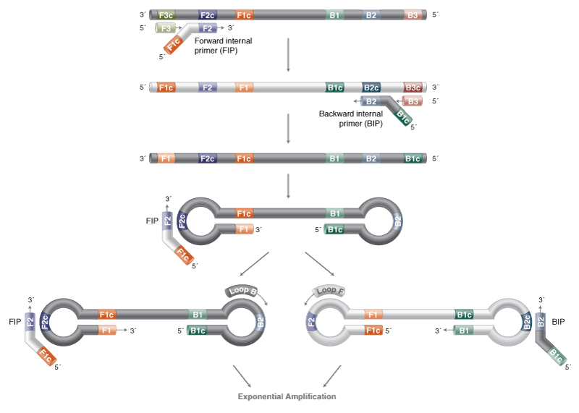
LAMP: Loop-Mediated Isothermal Amplification
Alternative molecular amplification technology
LAMP generates 10X more DNA product in 1/3 time compared to PCR
Can be formulated for easy visual/camera-based readout
Becoming an increasingly important part of diagnostics - many LAMP COVID EUAs!
 | qPCR | LAMP
Equipment | qPCR machine (thermal cycler & optics) | simple heat block or water bath (isothermal)
Time | 90 min | 30 min
Capital Cost | $30K-100K | $300
Recommend NEB website and
global LAMP consortium review: (FloodLAMP co-author)
https://drive.google.com/file/d/1qdf-dL2cmbB7aK4rw57CgjPmWQ9K5X0F
FLOODLAMP ARCHIVE FILE PATH: various/glamp/gLAMP Global Consortium - JBT Review Paper (Sept 2021).md

Slide 8
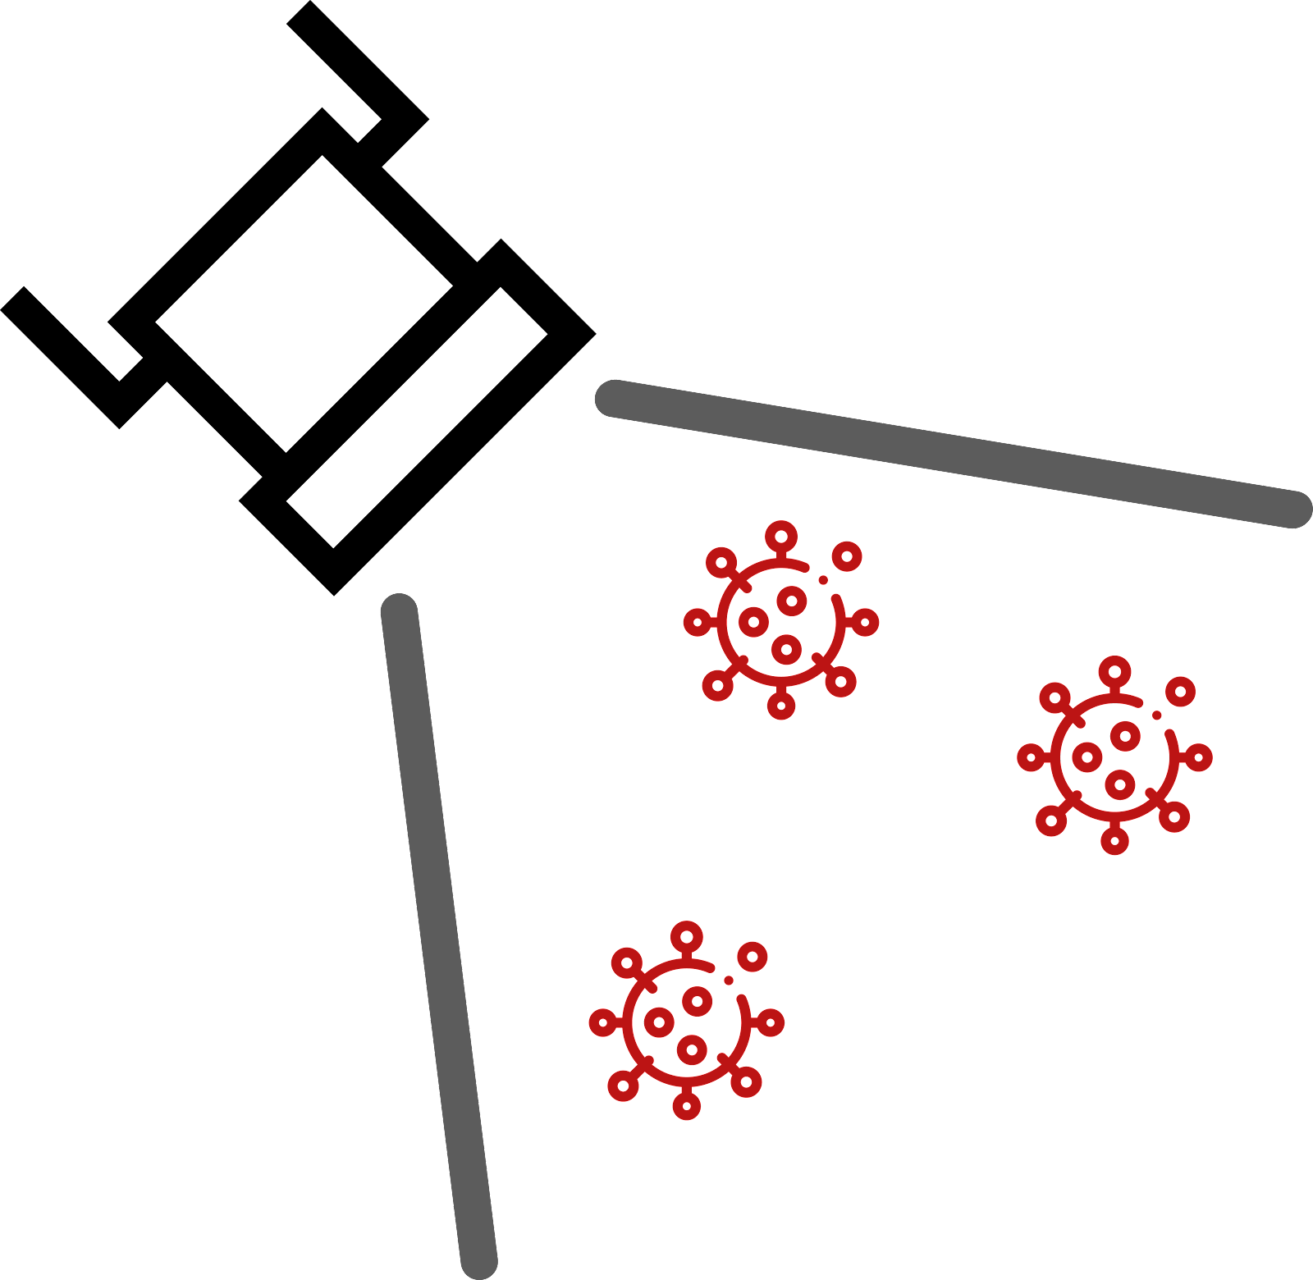

Molecular Assay Atlas
PEOPLE
SAMPLE
INACTIV
PURIFIC
AMPLIF
READOUT
Individual
Nasopharyngeal
Swab (NP)
TCEP (Chem)
+ Heat
Rabe Cepko, HUDSON
Glass Milk
Rabe Cepko
qPCR
qPCR Machine
Fluorescence
Cheek Swab
Proteinase K
(Enzyme) + Heat
Saliva Direct
Mag Beads
Kellner, Yu
LAMP
Colorimetric
Fluorimetric
Visual / Camera
Color Change
Pool: 2-20
Anterior Nares
Swab (AN)
Plate Reader
Absorbance
Color Genomics
Heat Only
Skip (Direct)
Misc
RPA, CRISPR, etc.
Saliva
Commercial
Zymo, Lucigen
Commercial
Thermo, Zymo, Kingfisher, Qiagen
Lateral Flow Strip
FloodLAMP Biotechnologies,
a Public Benefit Corporation
contact@floodlamp.bio

Slide 9
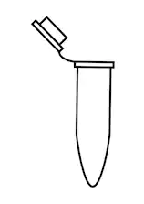
FloodLAMP Tests
SAMPLE
INACTIV
AMPLIF
READOUT
Colorimetric LAMP
FloodLAMP QuickColorTM
Visual / Camera
Fluorimetric LAMP
FloodLAMP QuickFluorTM
TCEP
FloodLAMP
EasyPCRTM
Sample
Indiv or Pooled
qPCR Machine
ProK
qPCR Amplification
SalivaDirectTM
FloodLAMP Biotechnologies,
a Public Benefit Corporation
contact@floodlamp.bio

Slide 10
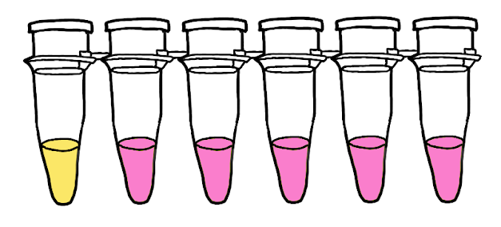

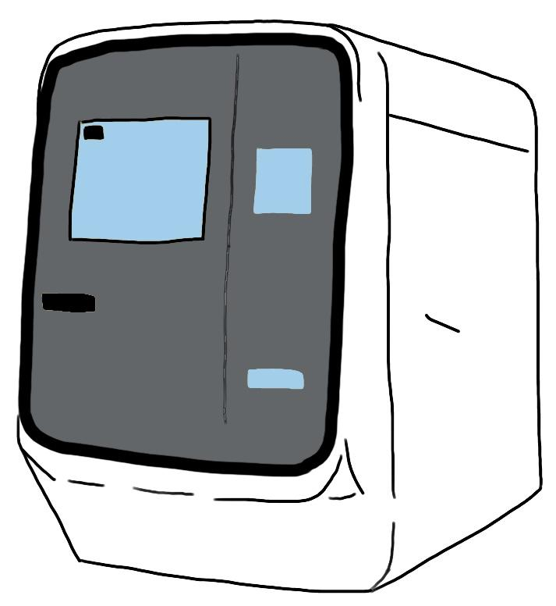
Direct PCR and LAMP Tests
visual readout
QuickColorTM LAMP Test
Colorimetric LAMP reaction
3 primer sets mixed (AS1e, N2, E1)
25 minutes at 65°C
Streamlined Sample Prep
Same sample for both tests
2µL sample volume
Shelf stable TCEP/EDTA inactivation solution
Added directly to dry swabs
Standard RT-qPCR instrument
EasyPCRTM Test
Multiple PCR Master Mixes Validated
CDC primers in SalivaDirect config (N1, RNAseP)

Slide 11
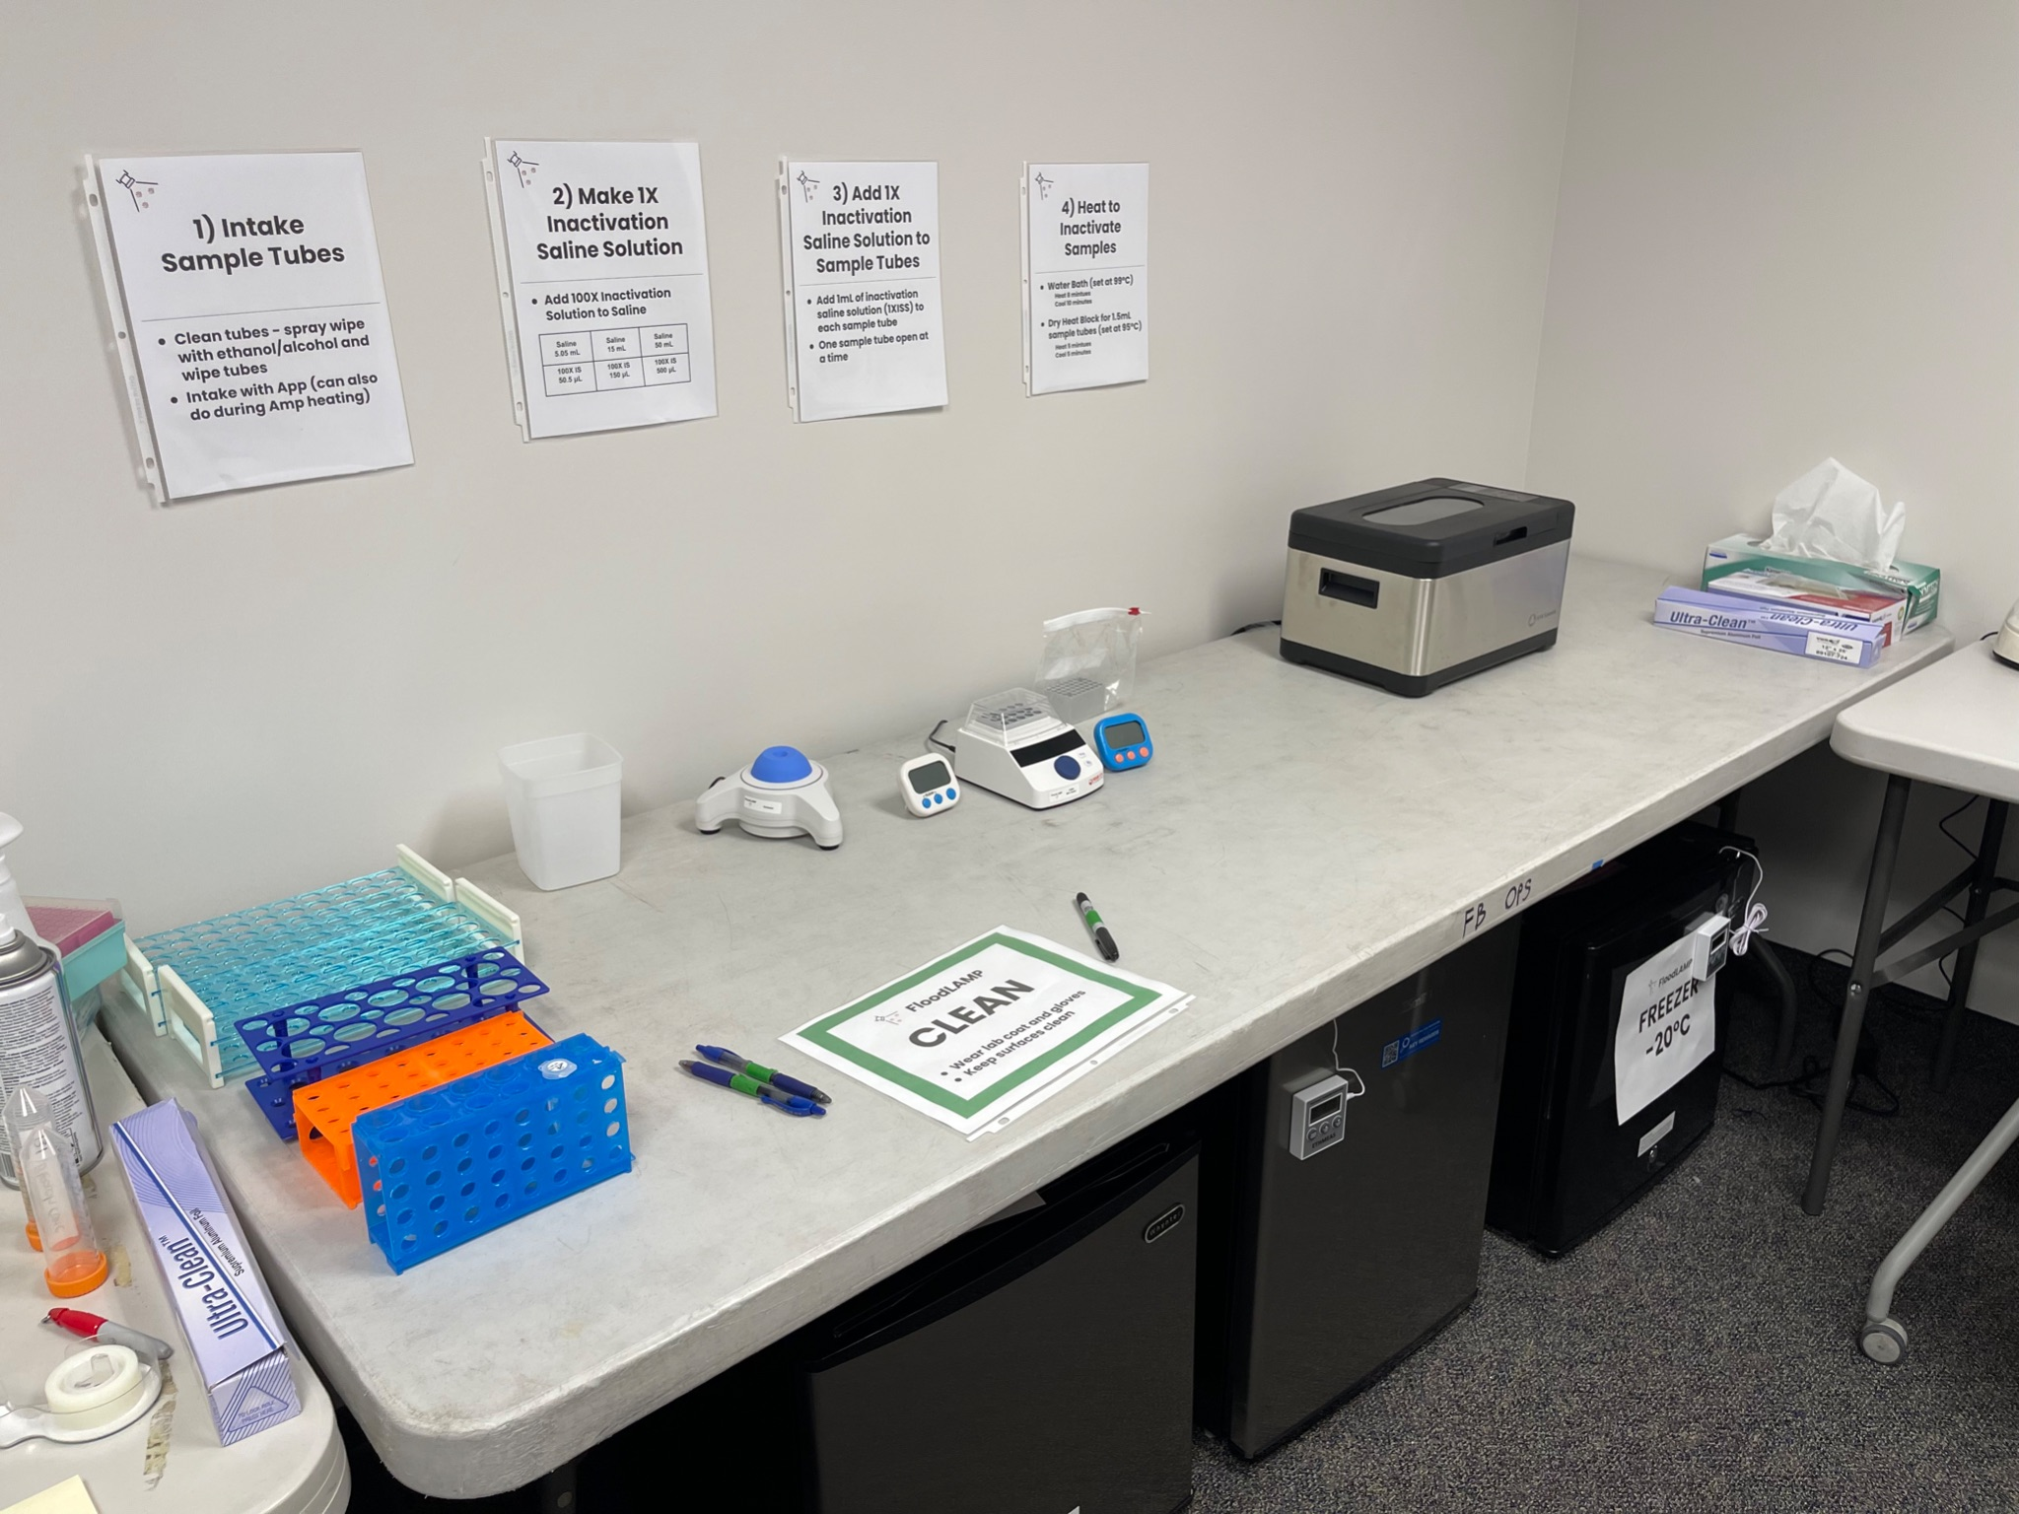
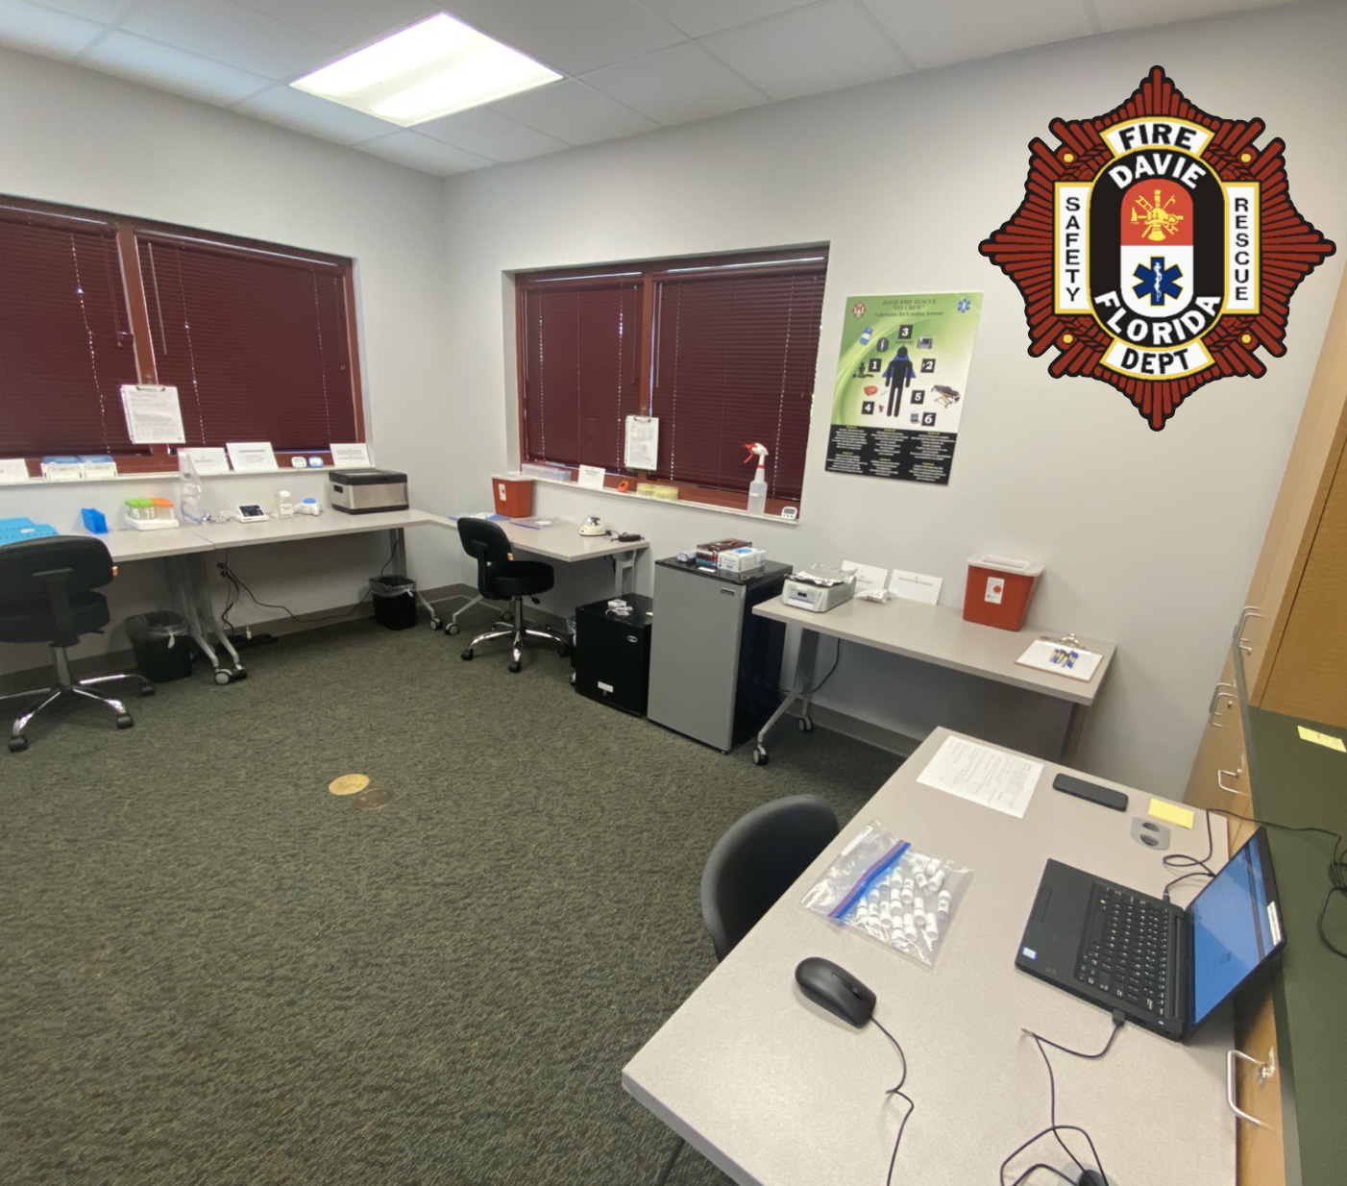
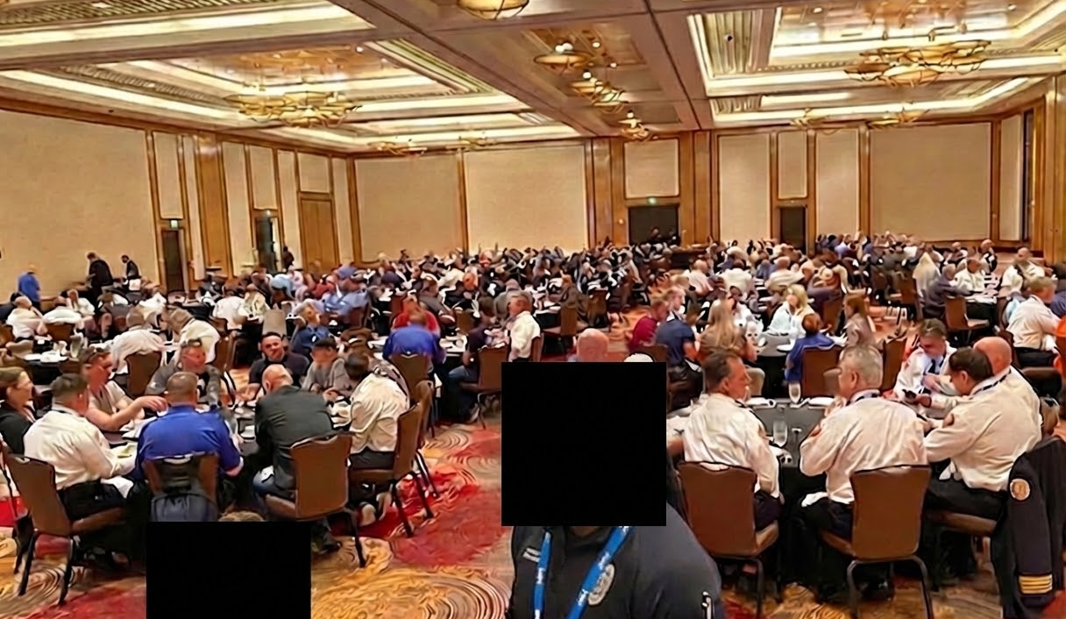
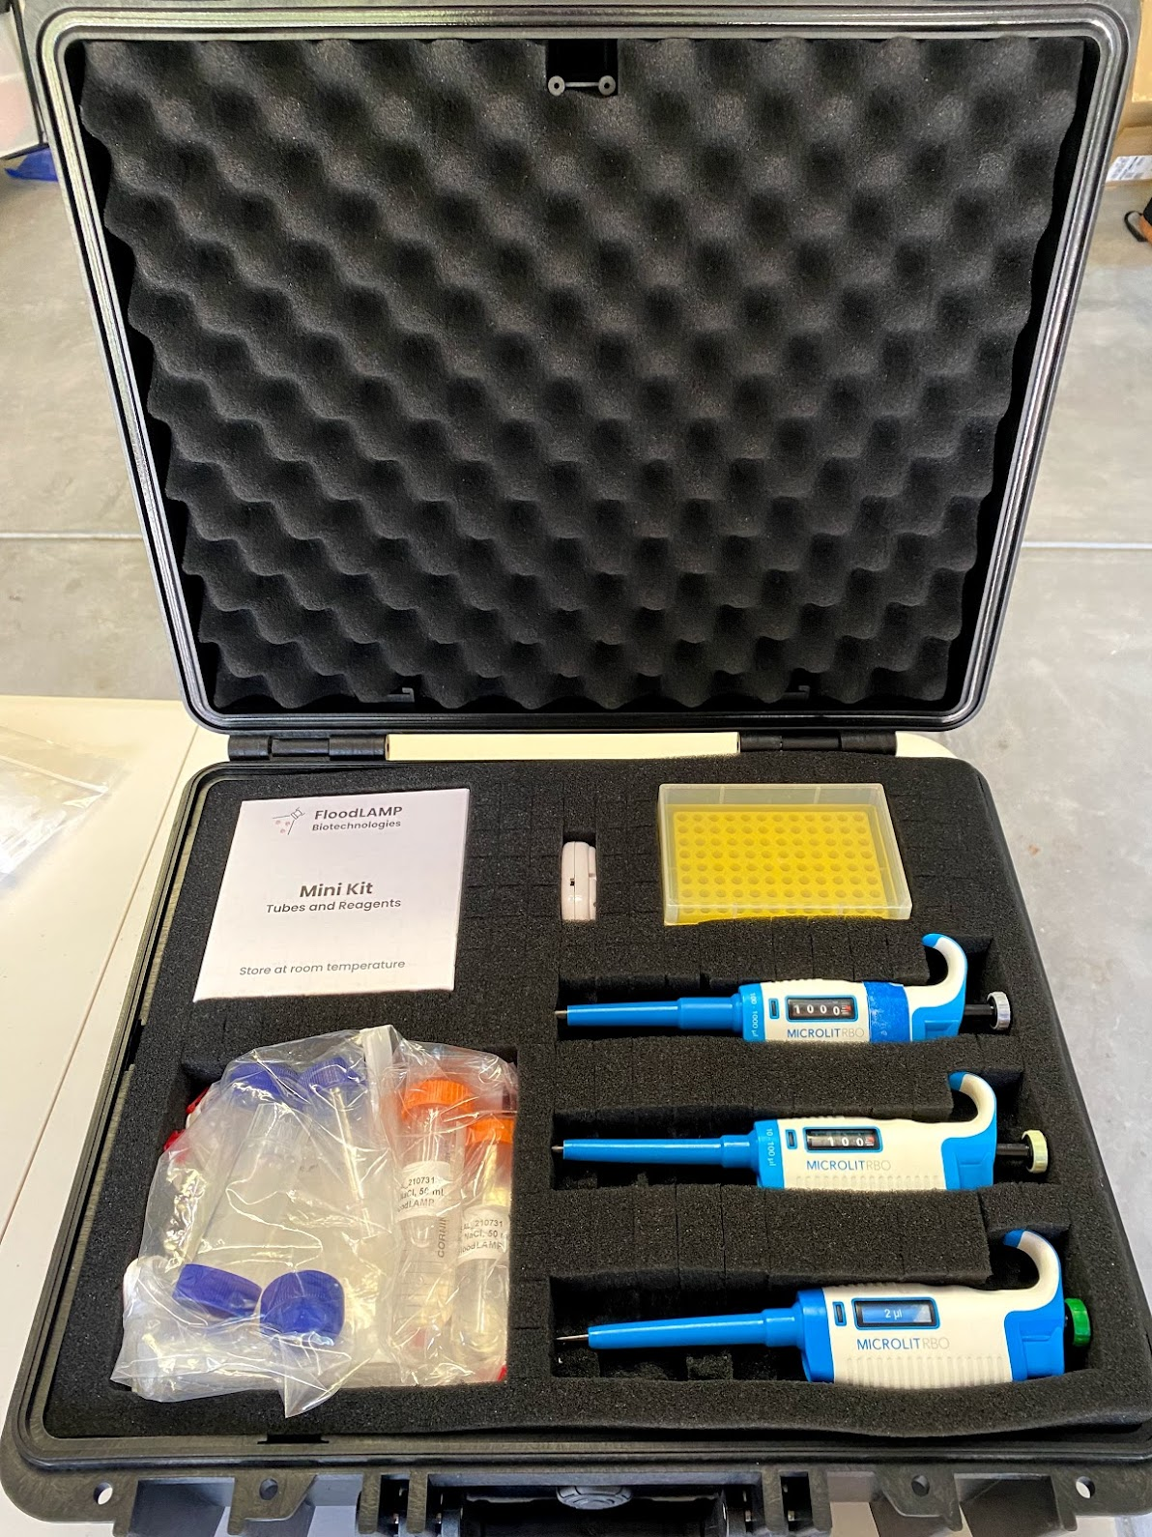
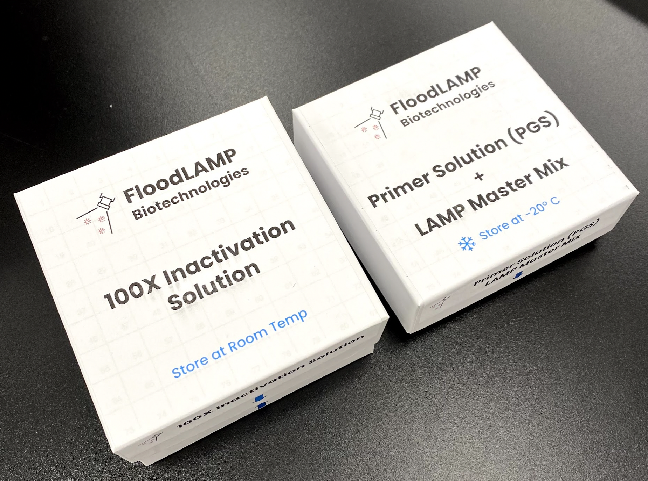
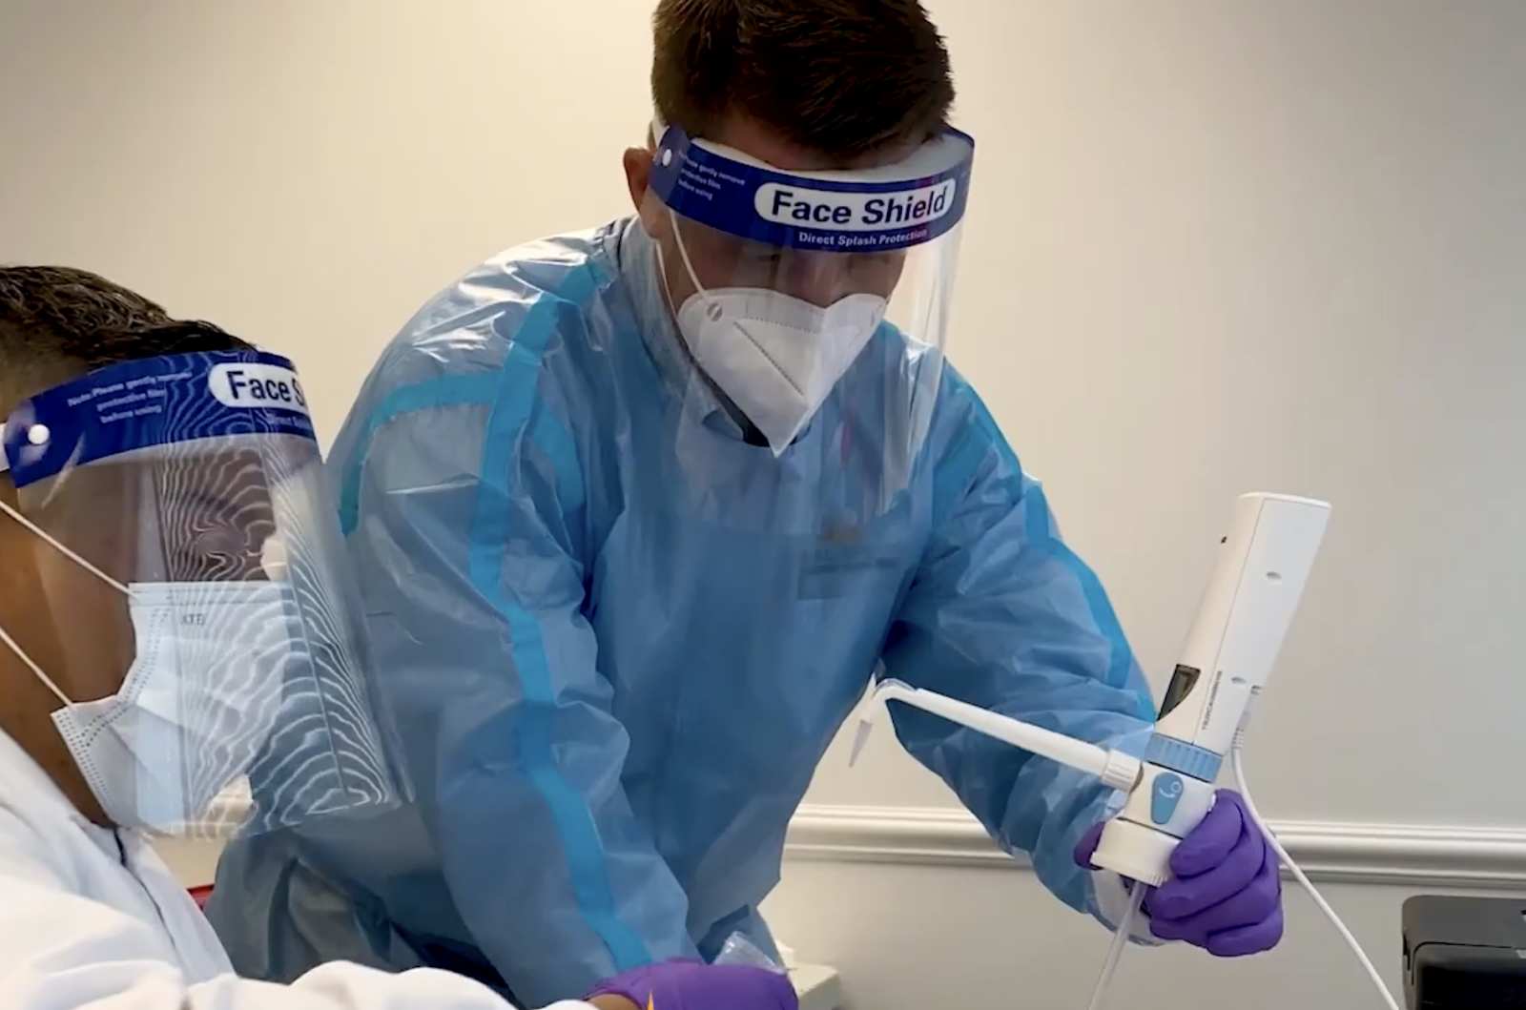
Ideal for Austere Sites

Slide 12
FloodLAMP Platform
Applications
COVID Response
Emerging Threats
(Pandemic Prep)
TB
Zika
Influenza
STD's
Cancer
Products
All-in
Test Kits
Reagent
Test Kits
Collection Kits
Standard Equipment
Standard Consumables
PHYSICAL
Sample Processing Sites (Labs)
Core
Modules
DIGITAL
App
Admin Portal
Training Program
Quality Management System
Service, Support,
Consulting
Network
EMS & Municipalities
Schools and Businesses
U.S. Federal Agencies
(BARDA, ASPR, CDC, DoD, FEMA)
International Governments
Testing Program Management

Slide 13
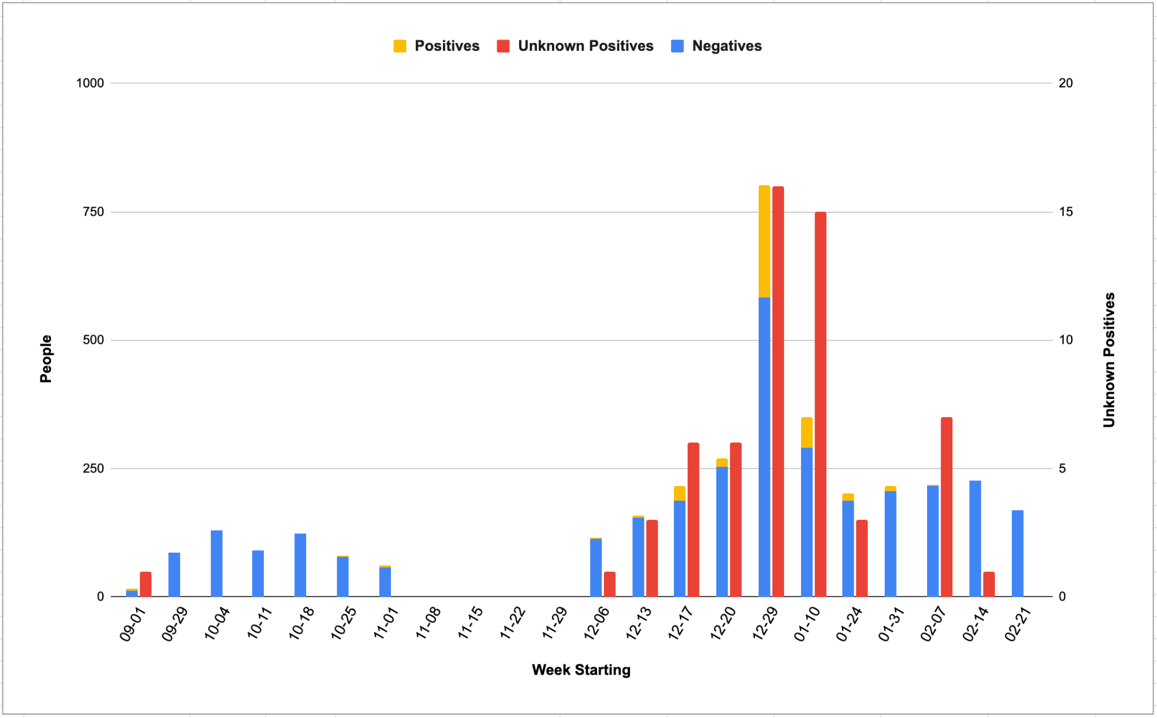
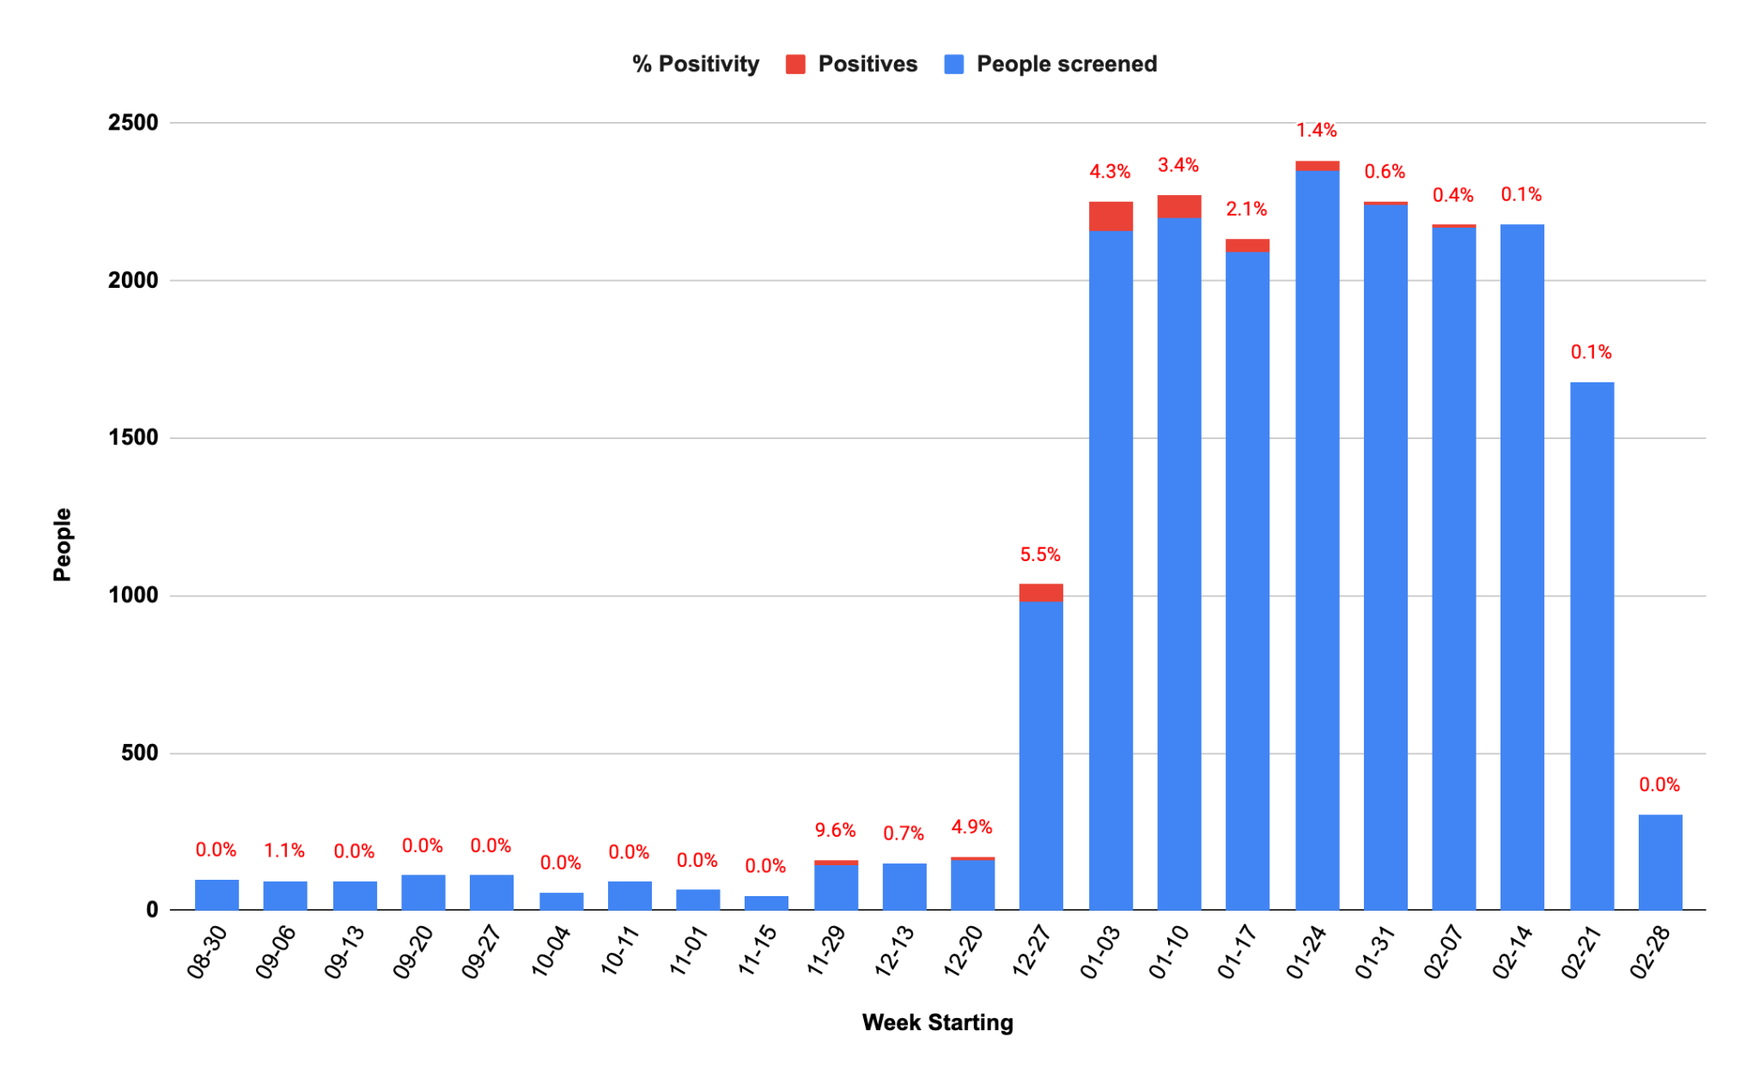
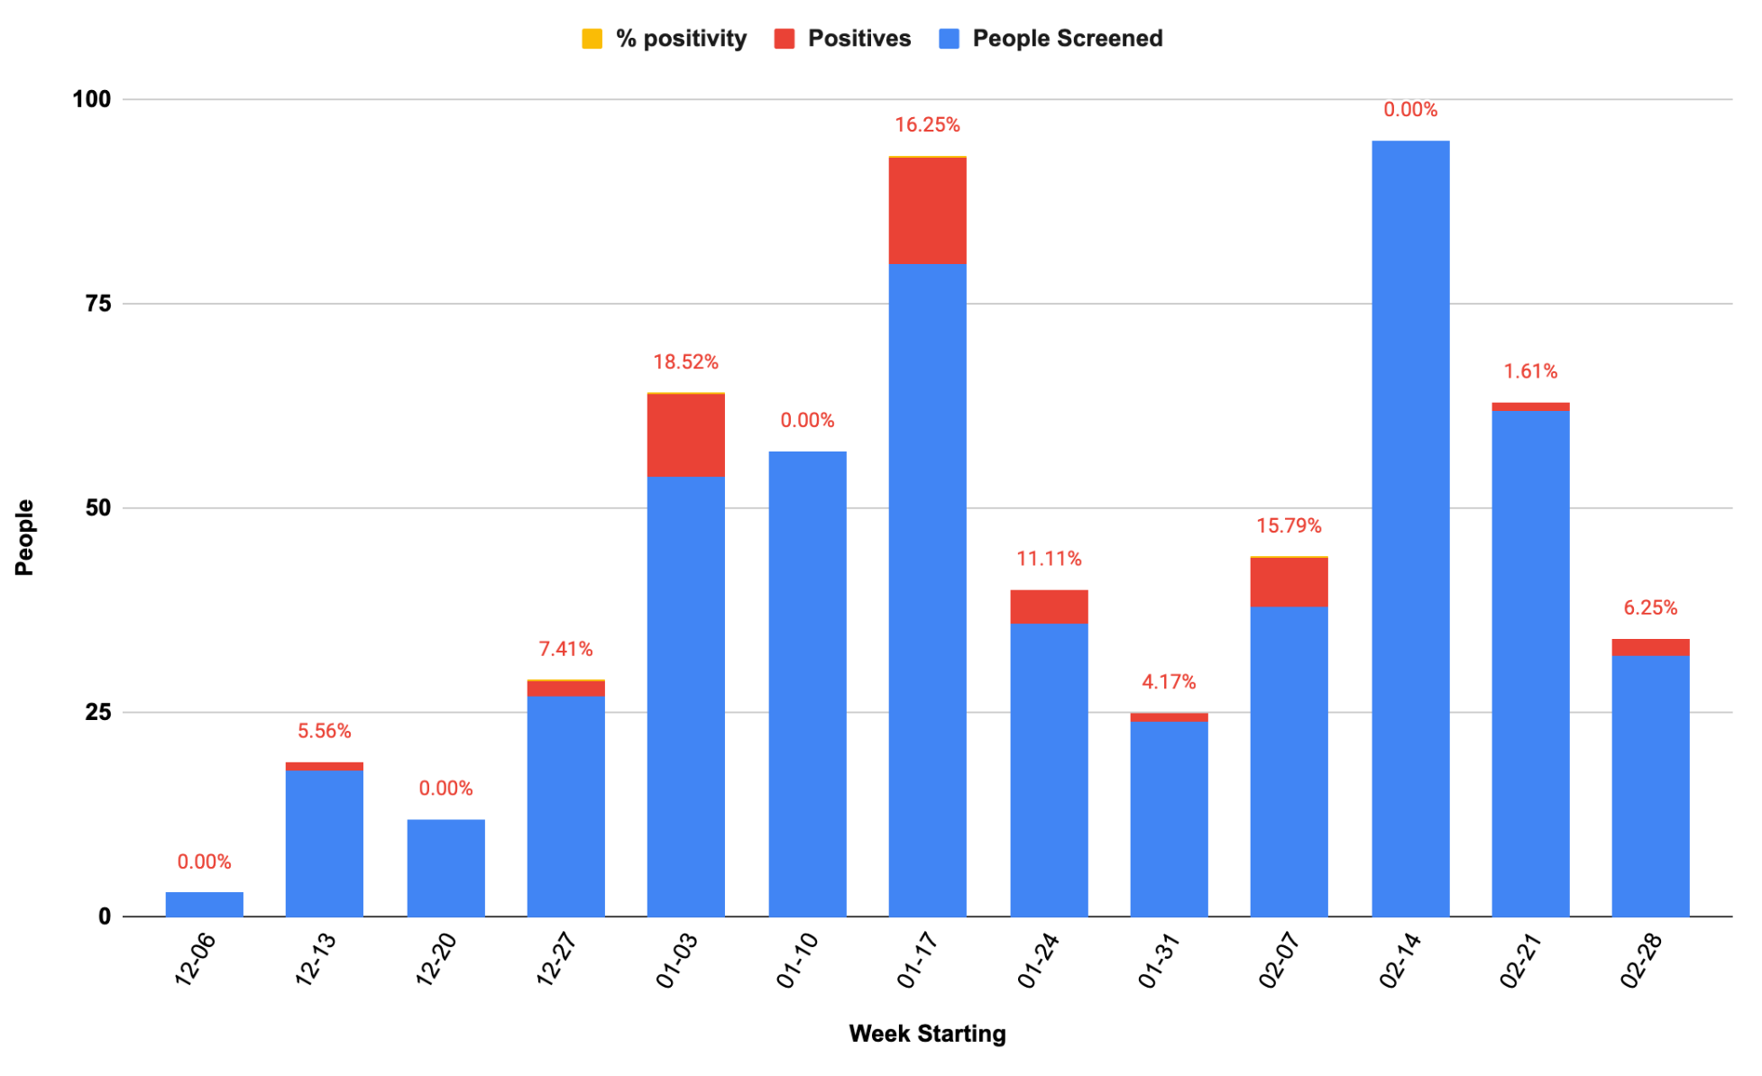
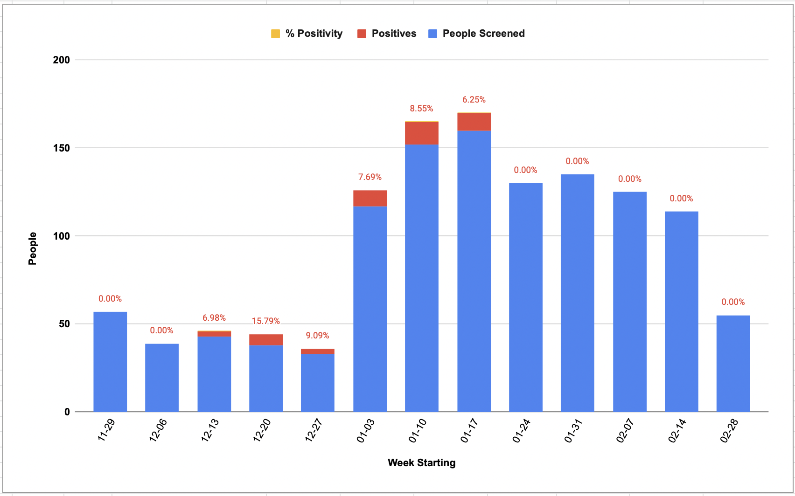
Scale Up During Omicron Surge
Davie, FL
EMS and Muni
Coral Springs, FL
EMS and Muni
Bend, OR
EMS
Bay Area, CA
Preschool

Slide 14

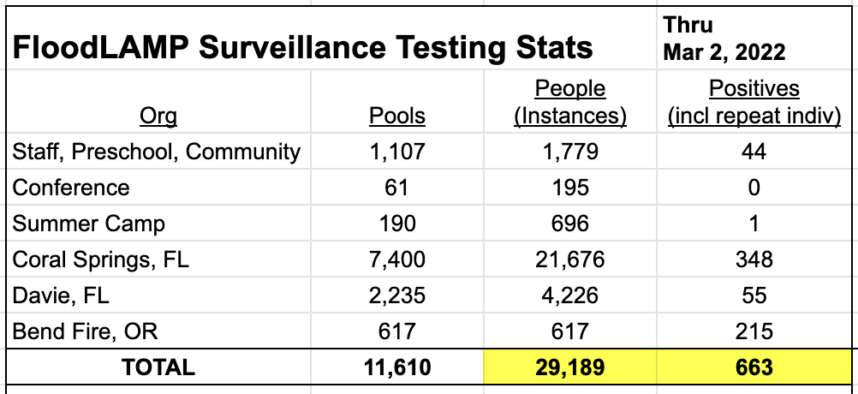
Real World Data
Comparison with diagnostic followup data in progress
22 FloodLAMP positives one day in late Dec and only 1 positive on BinaxNOW.
All 22 became positive over next few days (reported).
One site has 100% concordance of FloodLAMP positives with reflex PCR (34/34).
Known adverse results in >10K tests
1 suspected false negative (lower instance than discordant lab PCR to FloodLAMP and antigen)
2 suspected false positives
<1% to 5% rerun rate (initial inconclusives that rerun as negative)

Slide 15
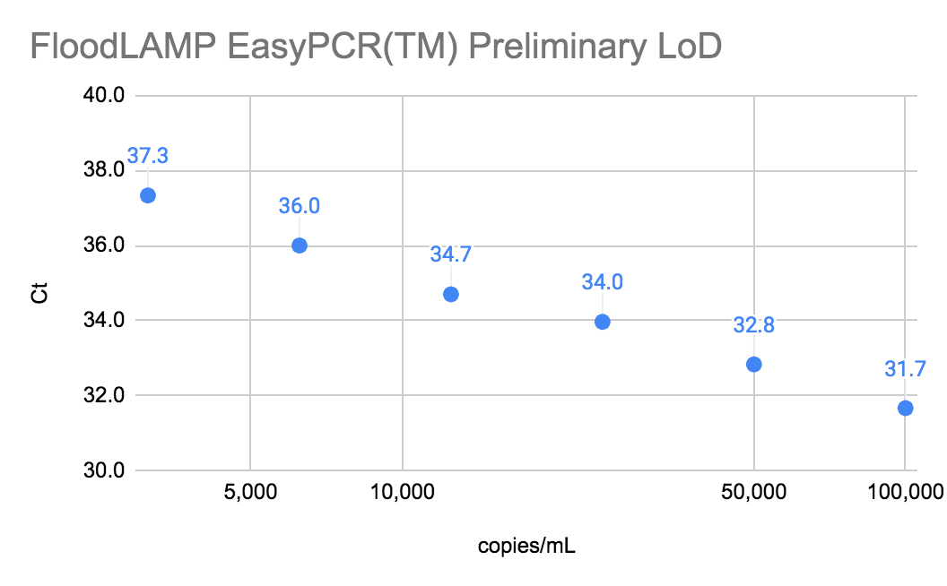
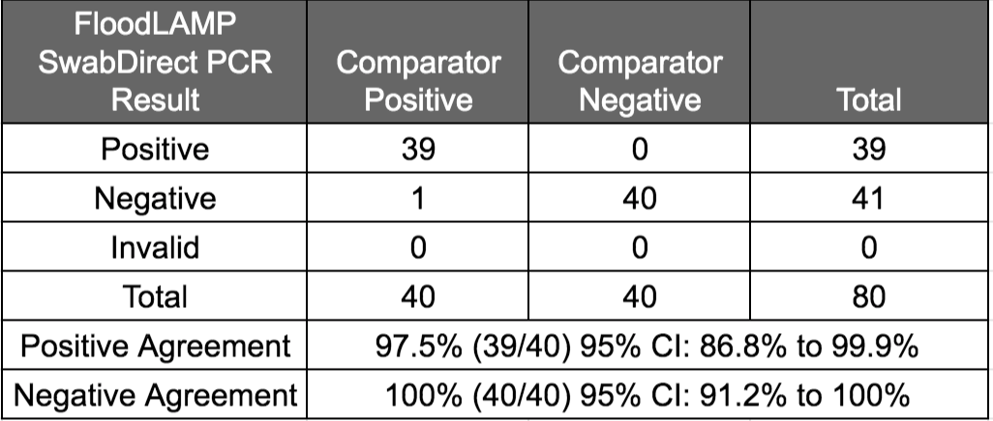
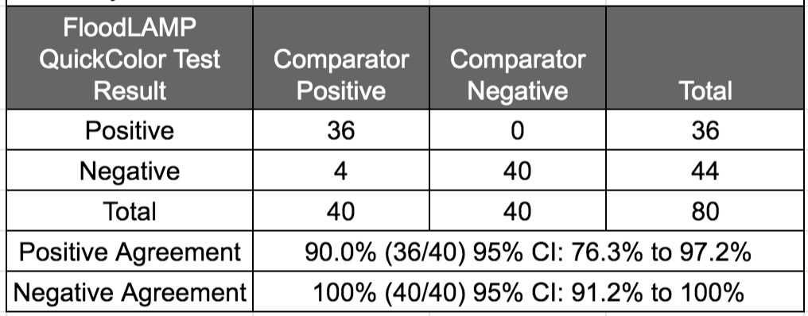
Clinical Evaluation Data
Clinical evaluation performed by the Stanford CLIA Lab, with excellent results and praise on the "really straightforward" protocol.
EasyPCRTM Test
3 copies/µl LoD
98% sensitivity (PPA 39/40)
100% Specificity (40/40)
No false positives
Gamma inactivated cell lysate from BEI spiked into raw clinical negative sample
QuickColorTM LAMP Test
12 copies/µl LoD
90% Sensitivity (PPA 36/40)
Missed positives only high Ct (>36 with direct PCR)
100% Specificity (40/40)
No false positives
Source of Specimens: Stanford COVID-19 Clinical Testing Program
Specimen Type: Anterior Nares Swab in PBS, previously tested and frozen
Comparator Test: Hologic Panther Fusion SARS-CoV-2 Assay and Hologic Panther Aptima SARS-CoV-2 Assay

Slide 16
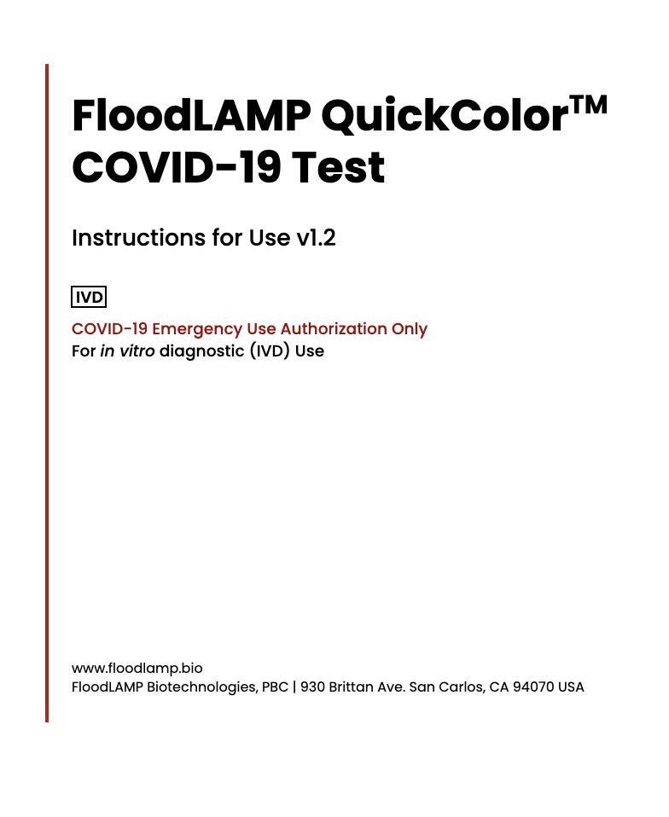
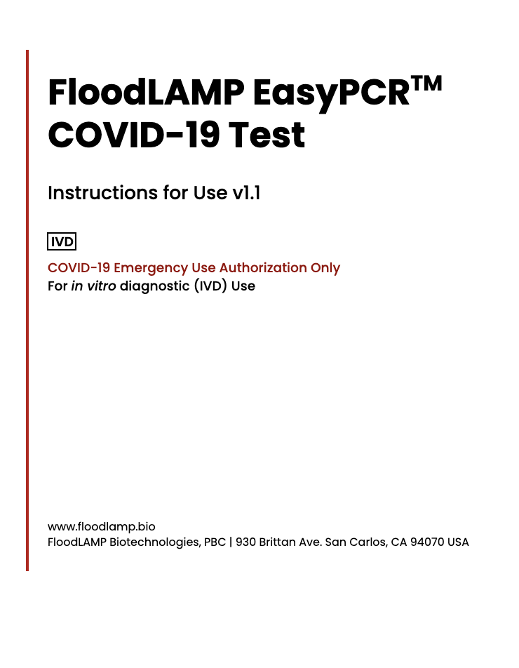
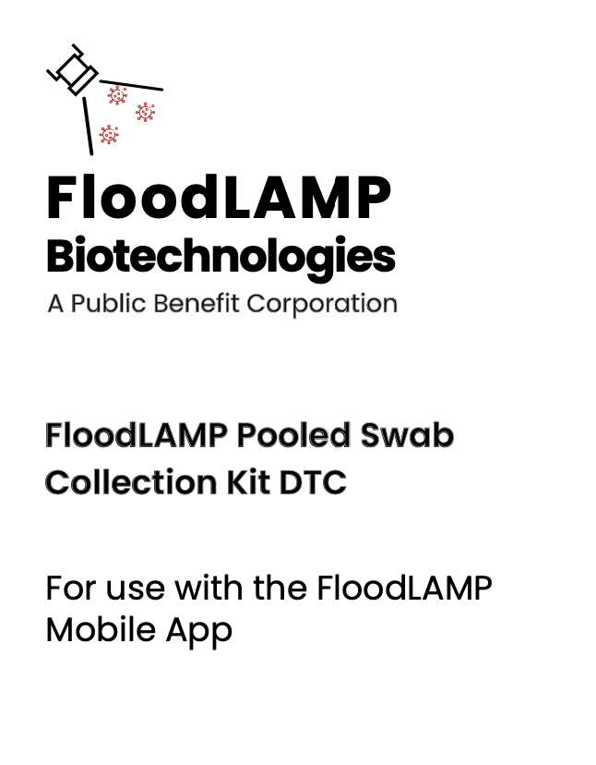
EUA Submissions - 2 Full + Pre EUA

Slide 17
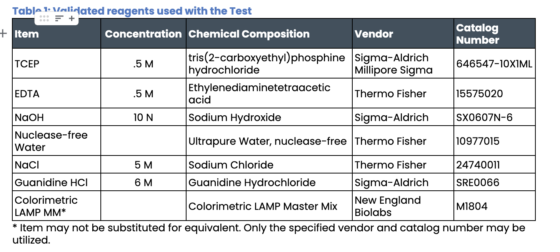
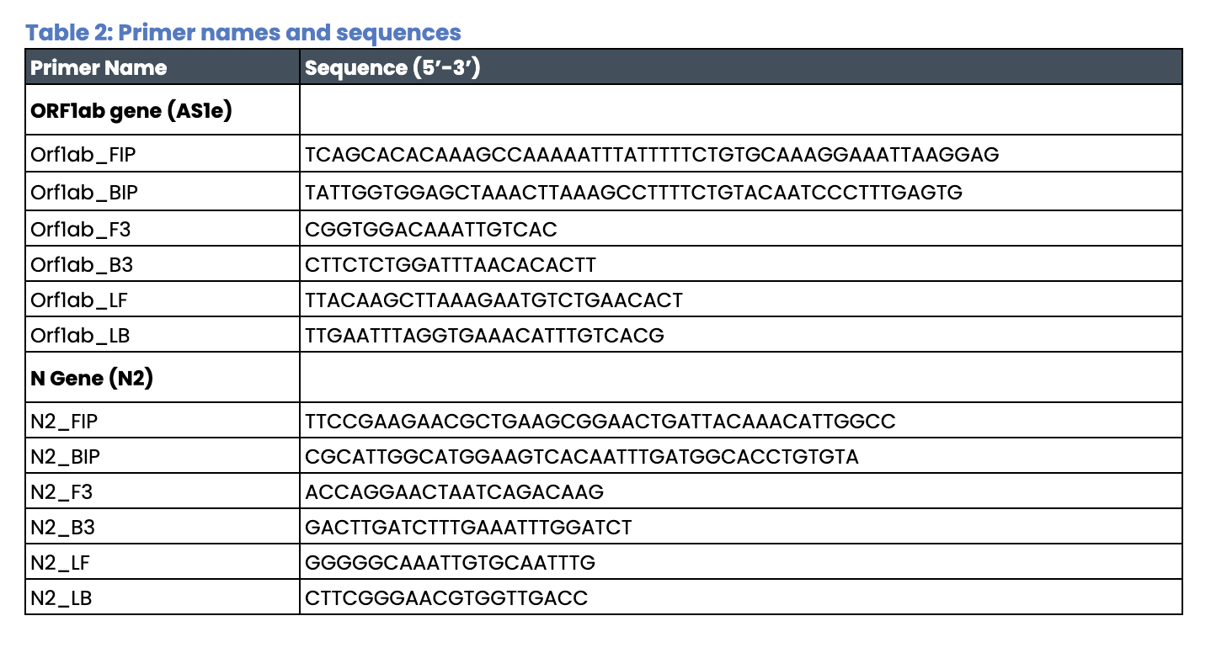
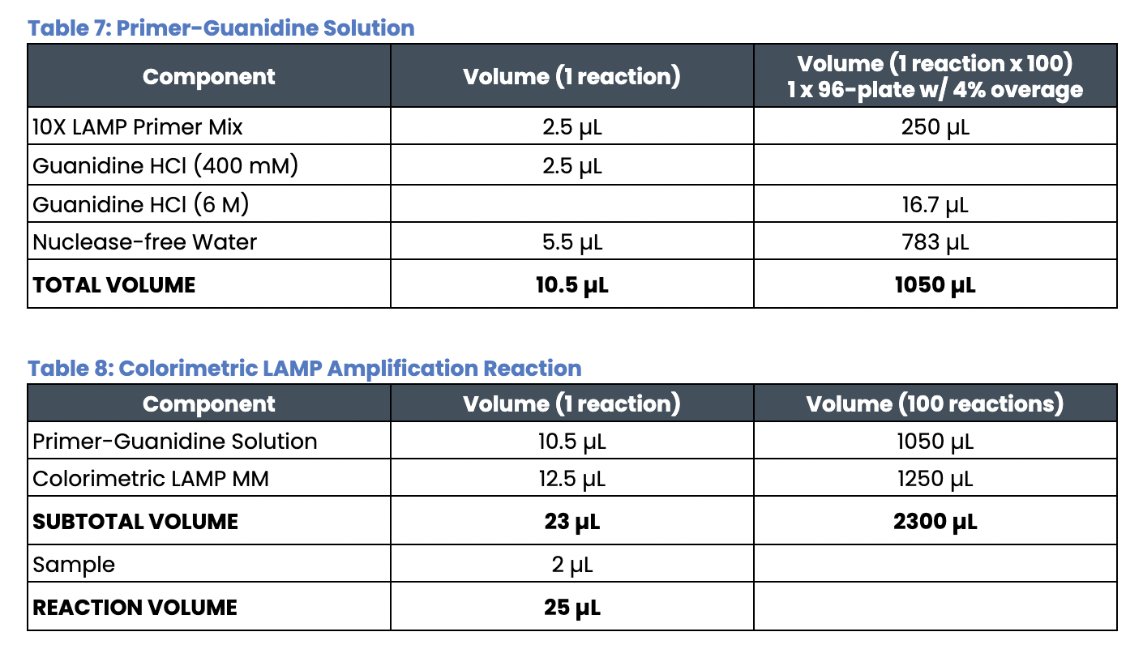
Open EUA - Disclosure of Components
In contrast to industry standard trade secret primer sequences and reaction components.

Slide 18
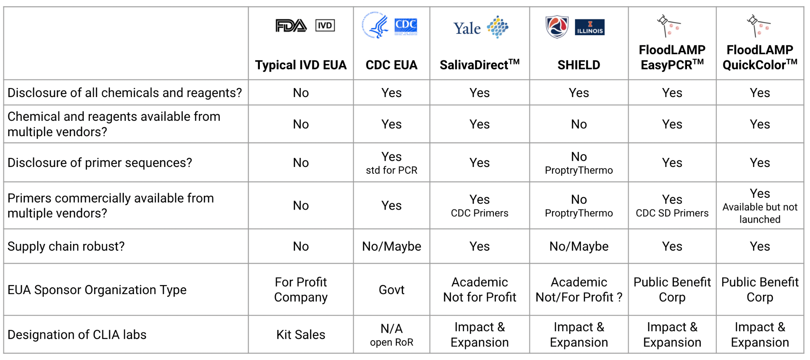
Open EUAs
Provides a path to establishing generics in diagnostics.
Enables global dissemination of highly respected FDA authorized tests.

Slide 19
FloodLAMP
Biotechnologies, PBC
Decentralized, Rapid, Molecular,
Disease Screening for $1
Randy True, Founder and CEO | randy@floodlamp.bio

